Slide 1
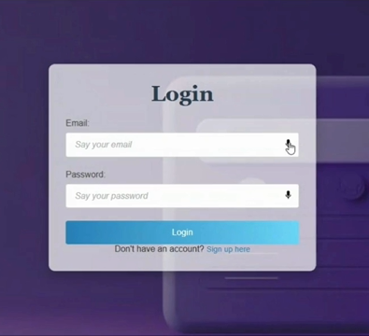

Voice-based College Admission Form Filling
This project explores the development of a voice-based college admission form filling system, leveraging the power of the Web Speech API to streamline the application process for prospective students.

Slide 2

Challenges of Traditional Form Filling
Time-Consuming
Error-Prone
Accessibility Barriers
Filling out forms can be tedious and time-consuming, especially for long and complex forms like college applications.
Manual data entry is prone to errors, which can lead to delays and frustration for both applicants and institutions.
Traditional forms can pose significant challenges for individuals with disabilities, such as those with motor impairments or visual impairments.

Slide 3


Introducing Web Speech API
Speech Recognition
Speech Synthesis
The API allows web applications to convert spoken language into text, enabling voice input for form fields.
The API also allows applications to synthesize text into spoken language.

Slide 4
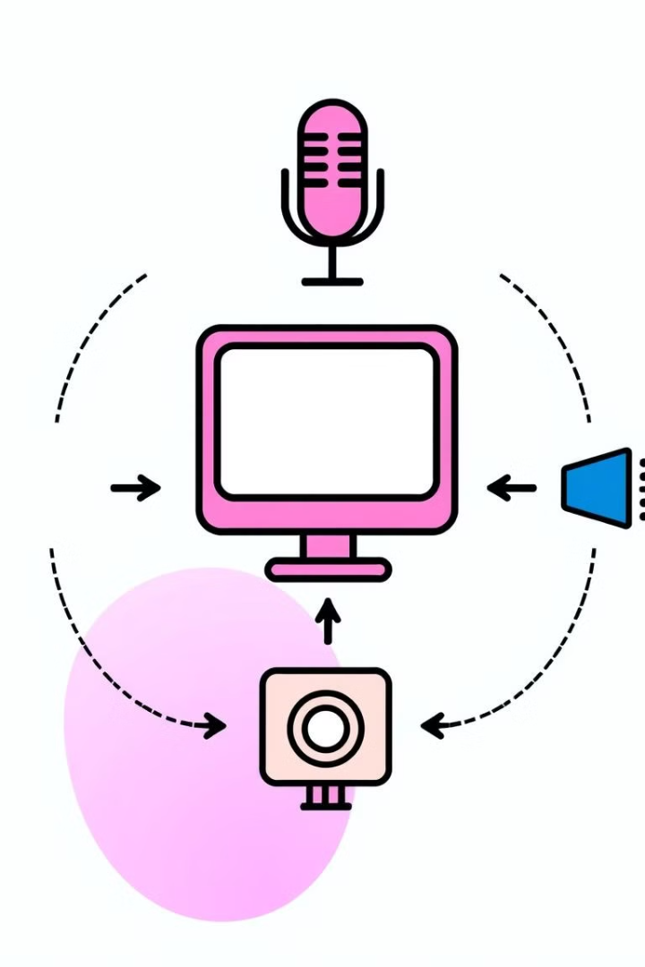




Voice Recognition and Synthesis
Speech Recognition
The API utilizes advanced algorithms to recognize and transcribe spoken language into text, transforming speech into data.
Text Processing
The transcribed text is then processed and validated to ensure accuracy and compliance with form requirements.
Speech Synthesis
The system can synthesize the processed data back into spoken language, providing auditory confirmation and feedback to the user.

Slide 5







Architecture of the Voice-based Form Filling System
User Interface
1
Provides a simple and intuitive interface for users to interact with the system through voice commands and feedback.
2
Speech Recognition Engine
Interprets spoken language into text, using advanced algorithms for accurate transcription.
3
Data Processing Module
Validates and processes the recognized text, ensuring data integrity and compliance with form requirements.
Form Template Engine
4
Generates and dynamically populates the form template based on the user's input, providing a seamless and efficient application process.
Database Integration
5
Securely stores and manages user data, ensuring confidentiality and accessibility for processing and retrieval.

Slide 6

Implementing the Voice-based Interaction
1
User Authentication
Securely authenticate the user through voice recognition or a unique identifier, ensuring data privacy and security.
2
Form Initialization
Load the relevant form template and initiate the voice-based interaction, providing clear instructions to the user.
3
Speech Input
Enable voice input and capture spoken responses from the user, processing the audio data in real-time.
Form Population
4
Dynamically populate the form fields based on the recognized text, updating the form in real-time to reflect the user's input.
Confirmation and Submission
5
Provide auditory confirmation of the completed form data, allowing the user to review and submit the application.

Slide 7
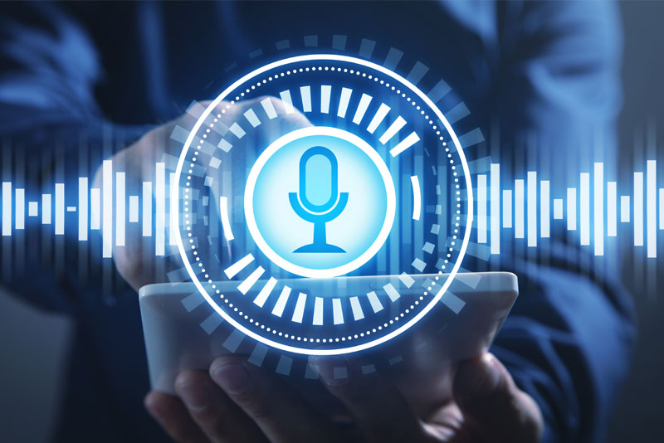

Benefits of Voice-based Form Filling
1
2
Convenience
Accessibility
Streamlines the application process, making it easier and faster for users to complete forms.
Provides a more inclusive experience for individuals with disabilities who may find traditional forms challenging.
3
4
Efficiency
Enhanced User Experience
Reduces the risk of errors and eliminates the need for manual data entry, saving time and resources.
Creates a more engaging user experience, making the application process less tedious and more enjoyable.

Slide 8




Conclusion and Future Considerations
This project demonstrates the potential of voice technology to transform the college application process. Future advancements in speech recognition, natural language processing, and AI can further enhance the accuracy, personalization, and user experience of voice-based form filling systems.

Slide 9
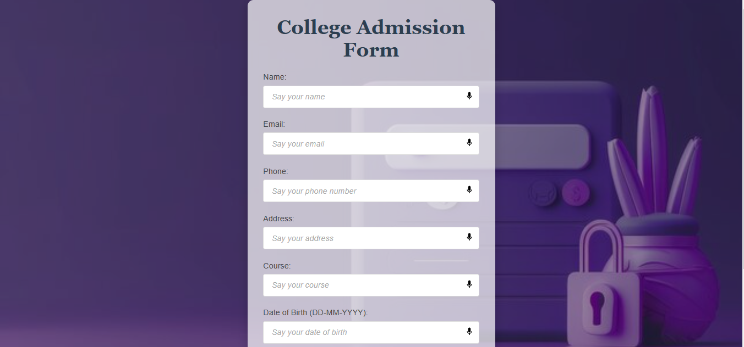

OUTPUT

